Slide 1
Applied AI
Lecture 2
Agents and Environments
Dr Artie Basukoski
[slides adapted from Artificial Intelligence: A Modern Approach, Russel and Norvigl]

Slide 2
Agenda
Agents and environments
Types of agents
Representing problems
Selecting a state space
Tree search algorithms
Breadth first search
Depth first search

Slide 3
Intelligent agents
Identify the concept of an intelligent agent.
Develop a small set of design principles for building successful agents.
Agents should be rational – one that does the right thing.
Behaviour depends on the environment and the goals that we define for the agents.
We define a number of basic agent designs.
Agent = Architecture + Program

Slide 4
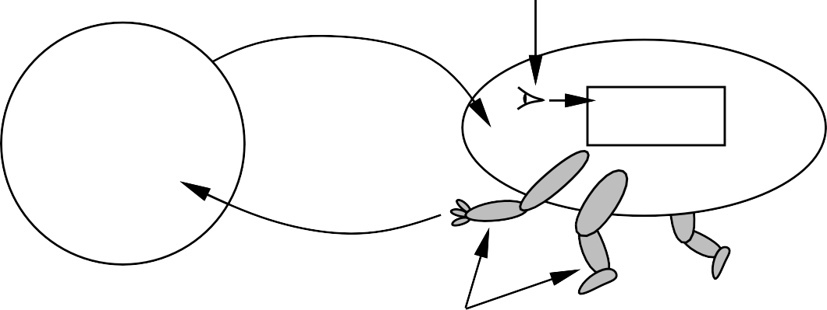
Agents and environments
sensors
percepts
?
agent
environment
actions
actuators
Agents include humans, robots, softbots, thermostats, etc. The agent function maps from percept histories to actions:
f : P∗ → A
The agent program runs on the physical architecture to produce f

Slide 5
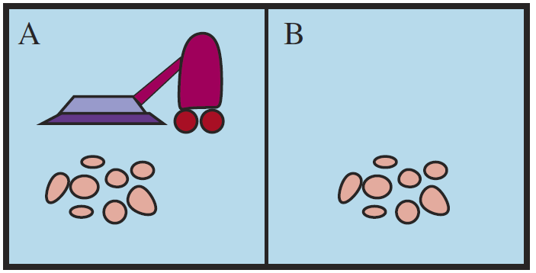







Vacuum-cleaner world
A B
Percepts: location and contents, e.g., [A, Dirty]
Actions: Left, Right, Suck, NoOp
Chapter 2

Slide 6
A vacuum-cleaner agent
Percept sequence | Action
[A, Clean] | Right
[A, Dirty] | Suck
[B, Clean] | Left
[B, Dirty] | Suck
[A, Clean], [A, Clean] | Right
[A, Clean], [A, Dirty] | Suck
. | .
function Reflex-Vacuum-Agent( [location,status]) returns an action
if status = Dirty then return Suck else if location = A then return Right else if location = B then return Left
What is the right function?
Can it be implemented in a small agent program?
The key challenge for AI is to find out how to write programs that, to the extent possible,
produce rational behavior from a smallish program rather than from a vast table.
Chapter 2

Slide 7
Rationality
What is rational at any given time depends on four things:
The performance measure that defines the criteria of success
The agents prior knowledge of the environment
The actions that the agent can perform
The agents per subsequence to date
This leads to a definition of a rational agent
For each possible percept sequence, a rational agent should select an action that is expected
to maximize its performance measure, given the evidence provided by the percept
sequence and whatever built-in knowledge the agent has.

Slide 8
Rationality
Fixed performance measure evaluates the environment sequence
one point per square cleaned up in time T ?
one point per clean square per time step, minus one per move?
penalize for > k dirty squares?
A rational agent chooses whichever action maximizes the expected value of the performance measure given the percept sequence to date
Rational /= omniscient
-percepts may not supply all relevant information Rational /= clairvoyant
-action outcomes may not be as expected Hence, rational /= successful
Rational ⇒ exploration, learning, autonomy
Chapter 2

Slide 9
PEAS
To design a rational agent, we must specify the task environment
Consider, e.g., the task of designing an automated taxi:
Performance measure: safety, destination, profits, legality, comfort, . . .
Environment: streets/freeways, traffic, pedestrians, weather, . . .
Actuators: steering, accelerator, brake, horn, speaker/display, . . .
Sensors: video, accelerometers, gauges, engine sensors, keyboard, GPS, . . .
Chapter 2

Slide 10
Internet shopping agent
Performance measure: ??
Environment: ??
Actuators: ??
Sensors: ??
Chapter 2

Slide 11
Internet shopping agent
Performance measure: price, quality, appropriateness, efficiency
Environment: current and future WWW sites, vendors, shippers
Actuators: display to user, follow URL, fill in form
Sensors: HTML pages (text, graphics, scripts)
Chapter 2

Slide 12
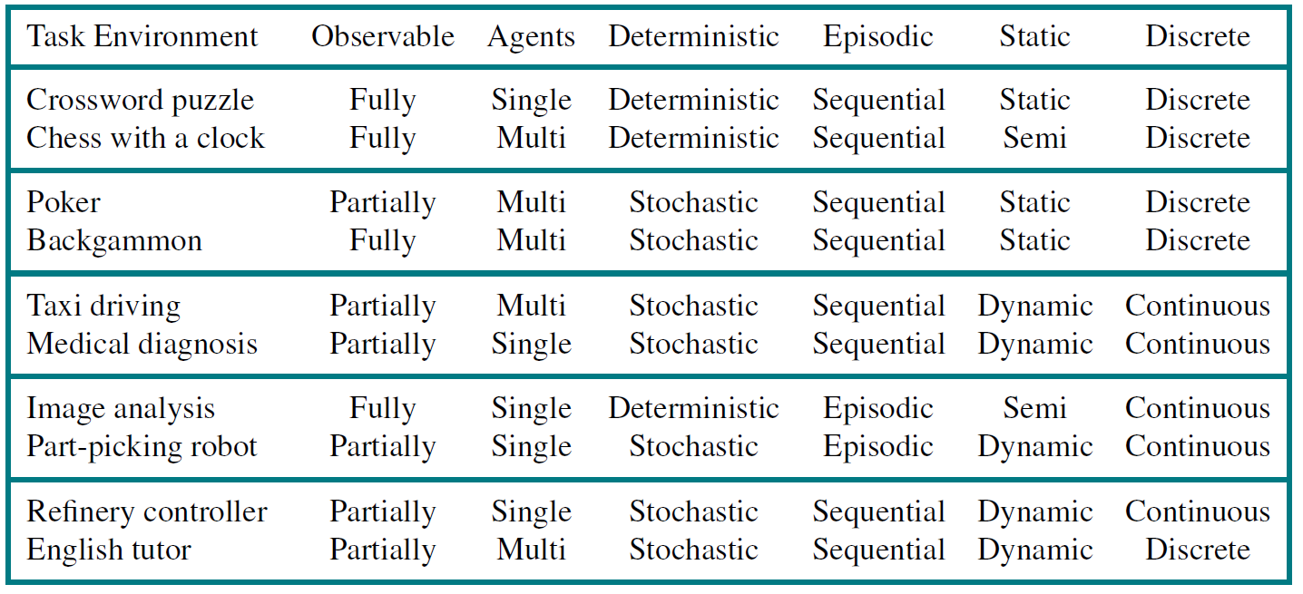
Environment types
The environment type largely determines the agent design
The real world is (of course) partially observable, stochastic, sequential, dynamic, continuous, multi-agent
Chapter 2

Slide 13
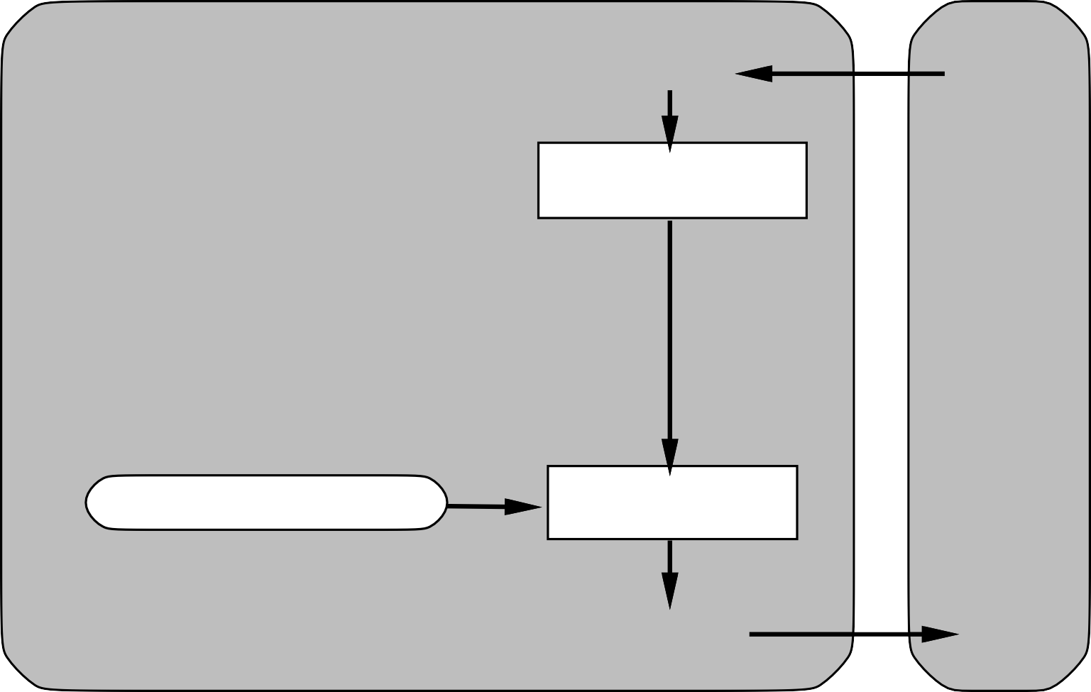
Simple reflex agents
Agent
Sensors
What the world is like now
Environment
What action I should do now
Condition−action rules
Actuators
function Reflex-Vacuum-Agent( [location,status]) returns an action
if status = Dirty then return Suck else if location = A then return Right else if location = B then return Left
Chapter 2

Slide 14
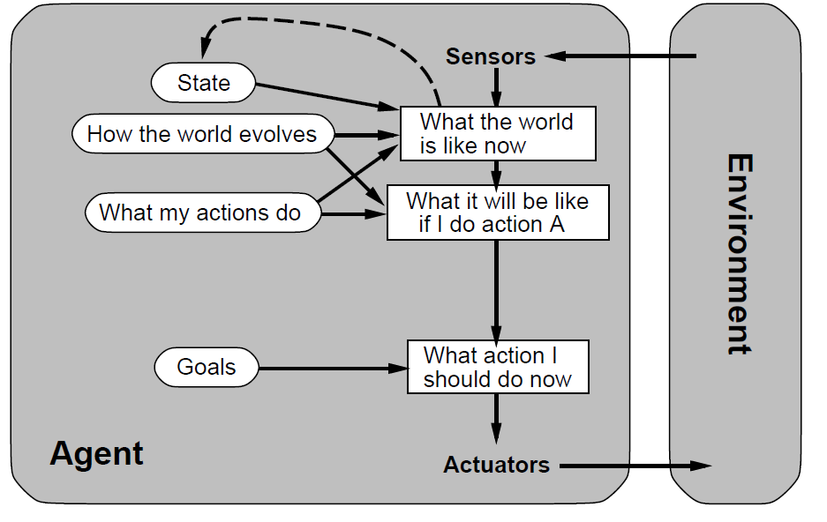
Goal-based agents

Slide 15
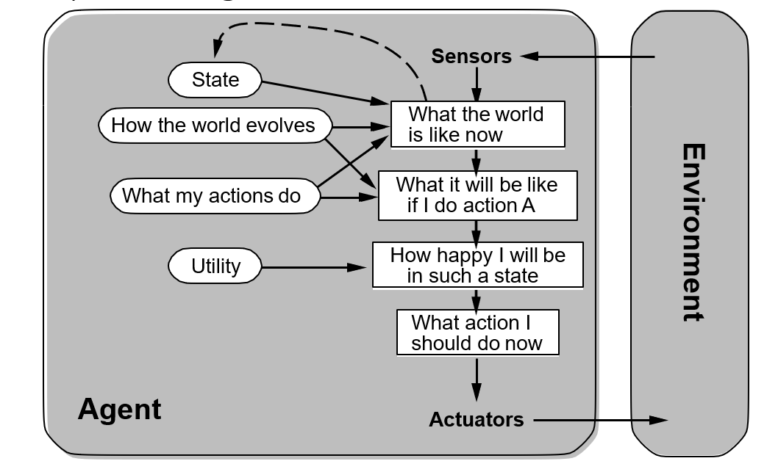
Utility based agents
Chapter 2

Slide 16
Agents summary
Agents interact with environments through actuators and sensors
The agent function describes what the agent does in all circumstances The performance measure evaluates the environment sequence
A perfectly rational agent maximizes expected performance Agent programs implement (some) agent functions
PEAS descriptions define task environments Environments are categorized along several dimensions:
observable? deterministic? episodic? static? discrete? single-agent?
Several basic agent architectures exist:
reflex, reflex with state, goal-based, utility-based
f : P∗ → A
Chapter 2

Slide 17
Example: Romania
On holiday in Romania; currently in Arad. Flight leaves tomorrow from Bucharest
Formulate goal:
be in Bucharest
Formulate problem:
states: various cities actions: drive between cities
Find solution:
sequence of cities, e.g., Arad, Sibiu, Fagaras, Bucharest
Chapter 3

Slide 18
Oradea
71
Neamt
Zerind
87
75
Arad
151
Iasi
140
92
Sibiu
Fagaras
99
118
Vaslui
80
Rimnicu Vilcea
Timisoara
211
142
111
Lugoj
Pitesti
97
70
98
146
85
Hirsova
Mehadia
101
Urziceni
75
Dobreta
138
86
Bucharest
120
90
Giurgiu
Craiova
Eforie
Chapter 3

Slide 19
Problem types
Deterministic, fully observable =⇒ single-state problem
Agent knows exactly which state it will be in; solution is a sequence
Non-observable =⇒ sensorless problem
Agent may have no idea where it is; solution (if any) is a sequence
Nondeterministic and/or partially observable =⇒ contingency problem percepts provide new information about current state
solution is a contingent plan or a policy often interleave search, execution
Unknown state space =⇒ exploration problem (“online”)
Chapter 3

Slide 20
Problem formulation
A problem is defined by four items:
initial state e.g., “at Arad”
successor function S(x) = set of action–state pairs
e.g., S(Arad) = {(Arad → Zerind, Zerind), . . .}
goal test, can be
explicit, e.g., x = “at Bucharest” implicit, e.g., NoDirt(x)
path cost (additive)
e.g., sum of distances, number of actions executed, etc.
c(x, a, y) is the step cost, assumed to be ≥ 0
Cost of applying action ‘a’ in state ‘x’ to reach state ‘y’
A solution is a sequence of actions from initial to a goal state
Chapter 3

Slide 21
Selecting a state space
A set of possible states that the environment can be in.
Real world is absurdly complex
⇒ state space must be abstracted for problem solving
(Abstract) state = set of relevant real states
(Abstract) action = complex combination of real actions e.g., “Arad → Zerind” represents a complex set
of possible routes, detours, rest stops, etc. For guaranteed realizability, any real state “in Arad”
must get to some real state “in Zerind”
(Abstract) solution =
set of real paths that are solutions in the real world
Each abstract action should be “easier” than the original problem!
Chapter 3

Slide 22
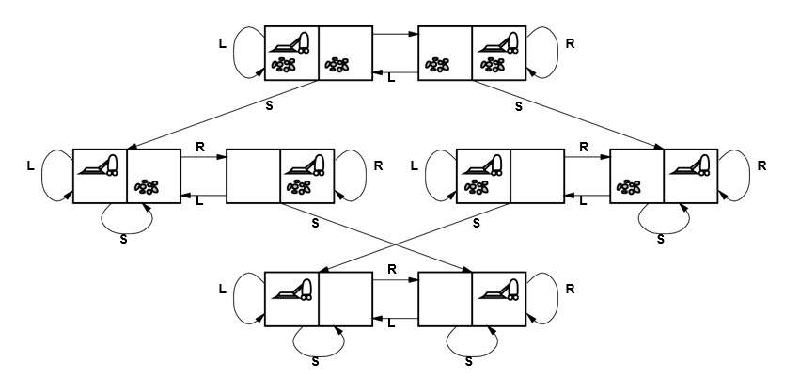
Example: Vacuum world state space graph
R
states: dirt and robot locations (ignore dirt amounts etc.)
actions: Left, Right, Suck, NoOp
goal test: no dirt
path cost: 1 per action (0 for NoOp)
Chapter 3

Slide 23
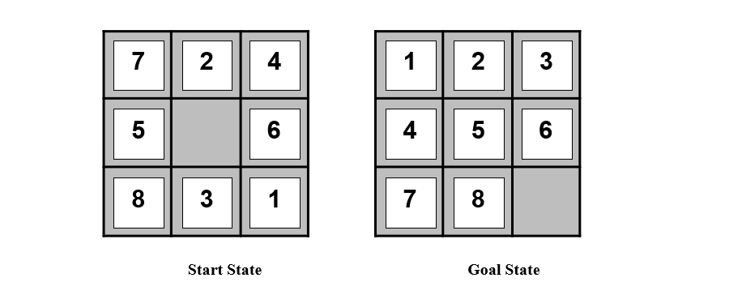
Example: The 8 puzzle
What are the possible next states?
Start State Goal State
states: integer locations of tiles (ignore intermediate positions) actions: move blank left, right, up, down (ignore unjamming etc.) goal test = goal state (given)
path cost: 1 per move
Chapter 3

Slide 24





Example: Robotic assembly
P
R
R
R
R
R
states: real-valued coordinates of robot joint angles parts of the object to be assembled
actions: continuous motions of robot joints
goal test: complete assembly with no robot included!
path cost: time to execute
Chapter 3

Slide 25
Tree search algorithms
Basic idea:
simulated exploration of state space
by generating successors of already-explored states (a.k.a. expanding states)
function Tree-Search( problem, strategy) returns a solution, or failure initialize the search tree using the initial state of problem
loop do
if there are no candidates for expansion then return failure choose a leaf node for expansion according to strategy
if the node contains a goal state then return the corresponding solution
else expand the node and add the resulting nodes to the search tree
end
Chapter 3

Slide 26
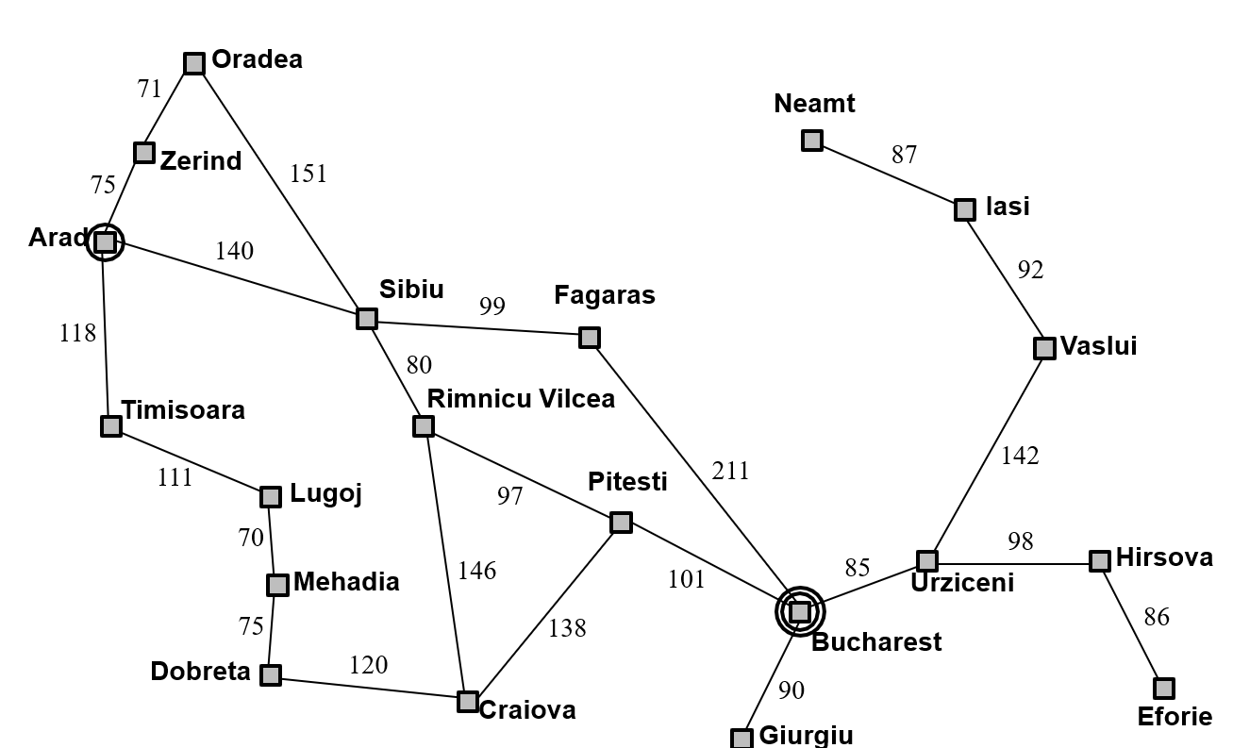
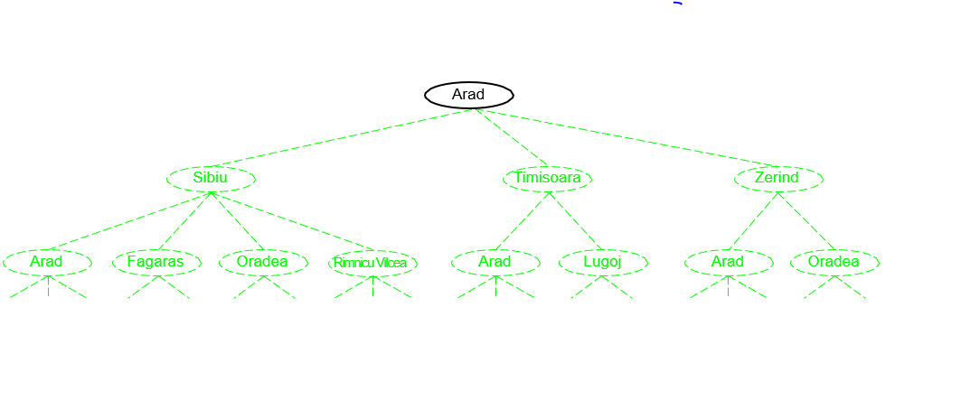
Tree search example
Chapter 3

Slide 27
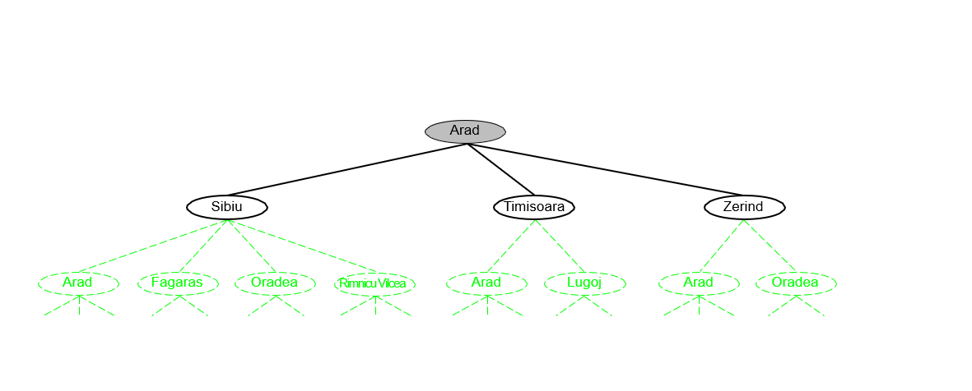
Tree search example
Chapter 3

Slide 28
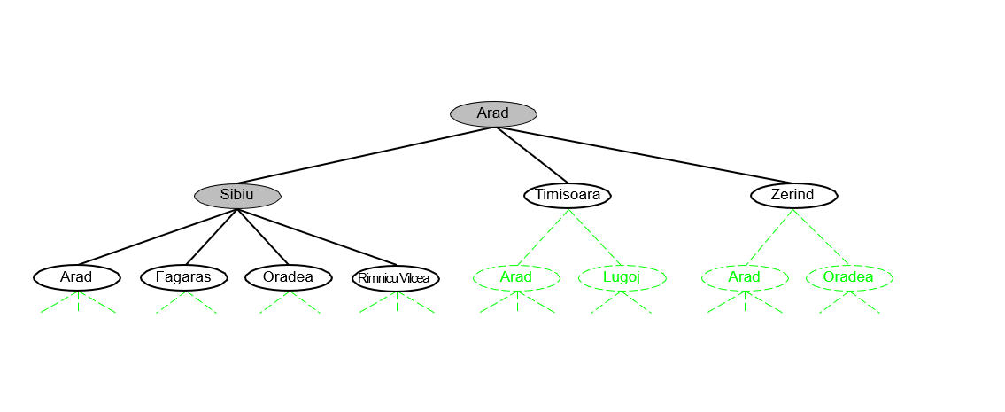
Tree search example
Chapter 3

Slide 29
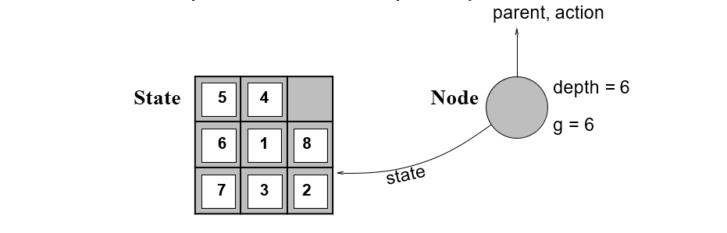
Implementation: states vs nodes
A state is a (representation of) a physical configuration
A node is a data structure constituting part of a search tree includes parent, children, depth, path cost g(x)
States do not have parents, children, depth, or path cost!
parent, action
The Expand function creates new nodes, filling in the various fields and using the SuccessorFn of the problem to create the corresponding states.
Chapter 3

Slide 30
Implementation: general tree search
function Tree-Search( problem, fringe) returns a solution, or failure fringe ← Insert(Make-Node(Initial-State[problem]), fringe) loop do
if fringe is empty then return failure
node ← Remove-Front(fringe)
if Goal-Test(problem, State(node)) then return node fringe ← InsertAll(Expand(node, problem), fringe)
function Expand( node, problem) returns a set of nodes
successors ← the empty set
for each action, result in Successor-Fn(problem, State[node]) do
s ← a new Node
Parent-Node[s] ← node; Action[s] ← action; State[s] ← result
Path-Cost[s] ← Path-Cost[node] + Step-Cost(node, action, s)
Depth[s] ← Depth[node] + 1 add s to successors
return successors
Chapter 3

Slide 31
Search strategies
A strategy is defined by picking the order of node expansion
Strategies are evaluated along the following dimensions: completeness—does it always find a solution if one exists? time complexity—number of nodes generated/expanded space complexity—maximum number of nodes in memory optimality—does it always find a least-cost solution?
Time and space complexity are measured in terms of b—maximum branching factor of the search tree d—depth of the least-cost solution
m—maximum depth of the state space (may be ∞)
Chapter 3

Slide 32
Uninformed the search strategies
Uninformed strategies use only the information available in the problem definition
Breadth-first search Uniform-cost search Depth-first search Depth-limited search
Iterative deepening search
Chapter 3

Slide 33
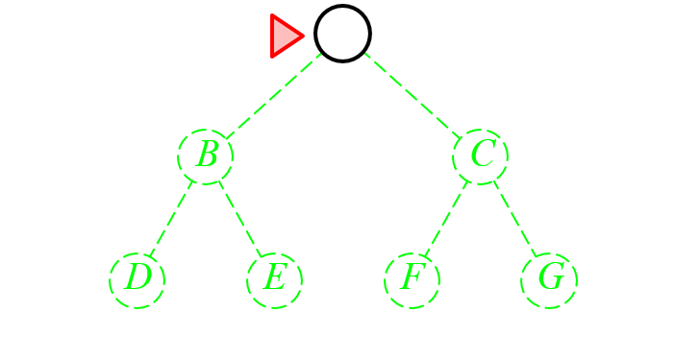
Breadth first search
Expand shallowest unexpanded node
Implementation:
fringe is a FIFO queue, i.e., new successors go at end
A
Chapter 3

Slide 34
Breadth first search
Expand shallowest unexpanded node
Implementation:
fringe is a FIFO queue, i.e., new successors go at end
A
B
C
D
E
F
G
Chapter 3

Slide 35
Breadth first search
Expand shallowest unexpanded node
Implementation:
fringe is a FIFO queue, i.e., new successors go at end
A
B
C
D
E
F
G
Chapter 3

Slide 36
Breadth first search
Expand shallowest unexpanded node
Implementation:
fringe is a FIFO queue, i.e., new successors go at end
A
B
C
D
E
F
G
Chapter 3

Slide 37
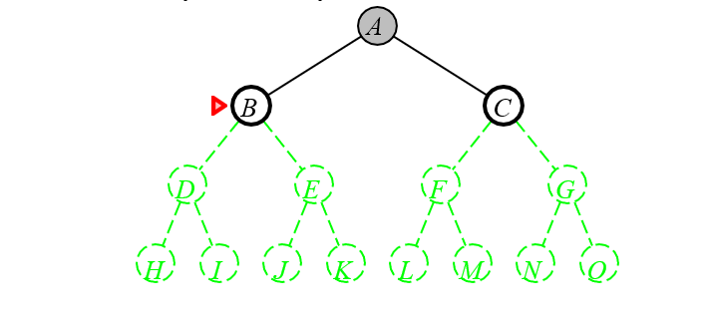
Depth first search
Expand deepest unexpanded node
Implementation:
fringe = LIFO queue, i.e., put successors at front
Chapter 3

Slide 38
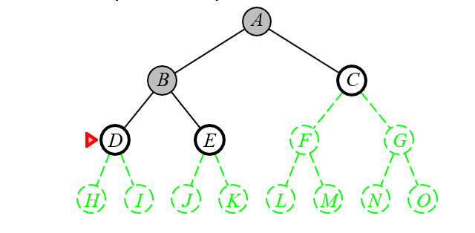
Depth first search
Expand deepest unexpanded node
Implementation:
fringe = LIFO queue, i.e., put successors at front
Chapter 3

Slide 39
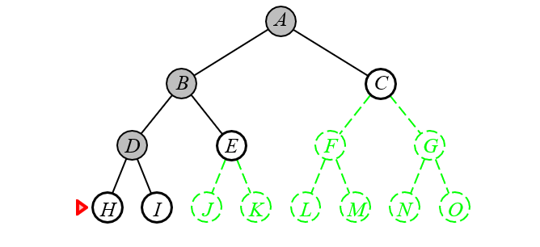
Depth first search
Expand deepest unexpanded node
Implementation:
fringe = LIFO queue, i.e., put successors at front
Chapter 3

Slide 40
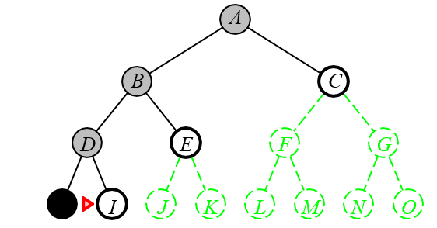
Depth first search
Expand deepest unexpanded node
Implementation:
fringe = LIFO queue, i.e., put successors at front
Chapter 3

Slide 41
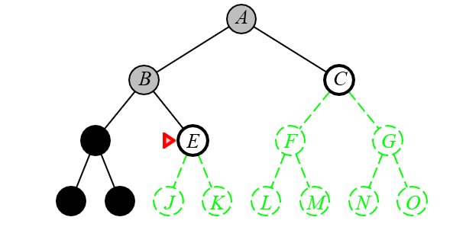
Depth first search
Expand deepest unexpanded node
Implementation:
fringe = LIFO queue, i.e., put successors at front
Chapter 3

Slide 42
Questions or comments

